Slide 1
L6 Group-1 Pitch 2
Caitlin White, Connor Wilby, Jamie Chandler and Jordan Marks

Slide 2
Our Brief

Slide 3
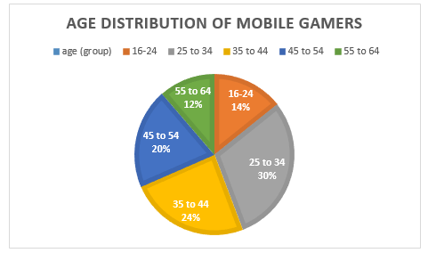
Demographic
Age: 25-34
Gender: Female
Source: http://www.realitymine.com/myth-busting-mobile-gaming-demographics/

Slide 4
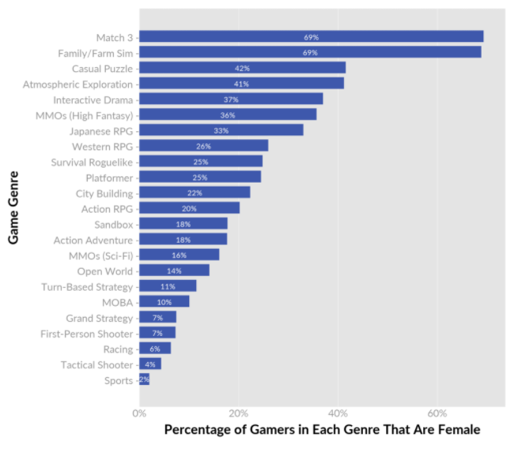
Psychographic
Doesn’t have much time to play games
Enjoys going online in the evenings to use social networks.
Enjoys shorter game sessions

Slide 5
Platform and Genre
Platform: Mobile and Tablet
Genre: Hex based Puzzle
Duration: Up to 5 minutes

Slide 6
The Game Loop
Level start
Swap tiles
Complete level
Earn rewards

Slide 7
Gameplay

Slide 8
Game Features (The Challenges)
Creating an unbroken chain of hexes
Using different hex types to reduce the number of moves this takes
Optimisation game
Hard Fun:
Accomplishment
Strategy
Clear Goal

Slide 9
Currency
Star-Dust
Used to refill the players lives
Used to buy power-ups to help the player in game
Pricing:
£0.99- Smallest amount
£4.99
£10.99-£15.99
£20-£40
£60-£80- Highest amount

Slide 10
Hex Tile Types

Slide 11
Power-ups

Slide 12
Artwork

Slide 13
Artwork

Slide 14
Artwork

Slide 15
Questions?

